Slide 2
STAND OUT!
(early)

Slide 3
The
Breakdown

Slide 4
The Breakdown
Early (Cycles 1-3) → sometimes 1-4 depending on the size of the round
DO YOUR PREP
Be Attentive to the Round
Don’t Be Afraid to Sound Important
You Tell the Judge What to Pay Attention to

Slide 5
Prep to Stand Out
Researching to Research
Looking at the Legislation Title
Going off of the first couple of links that pop up
Spending more time looking at problems than solutions
Researching to Be Noticed
Researching to learn warrants
Being able to know “why” something happens or “why” the legislation is even being proposed
Finding evidence that solutions work
Finding evidence that specific solutions work

Slide 6
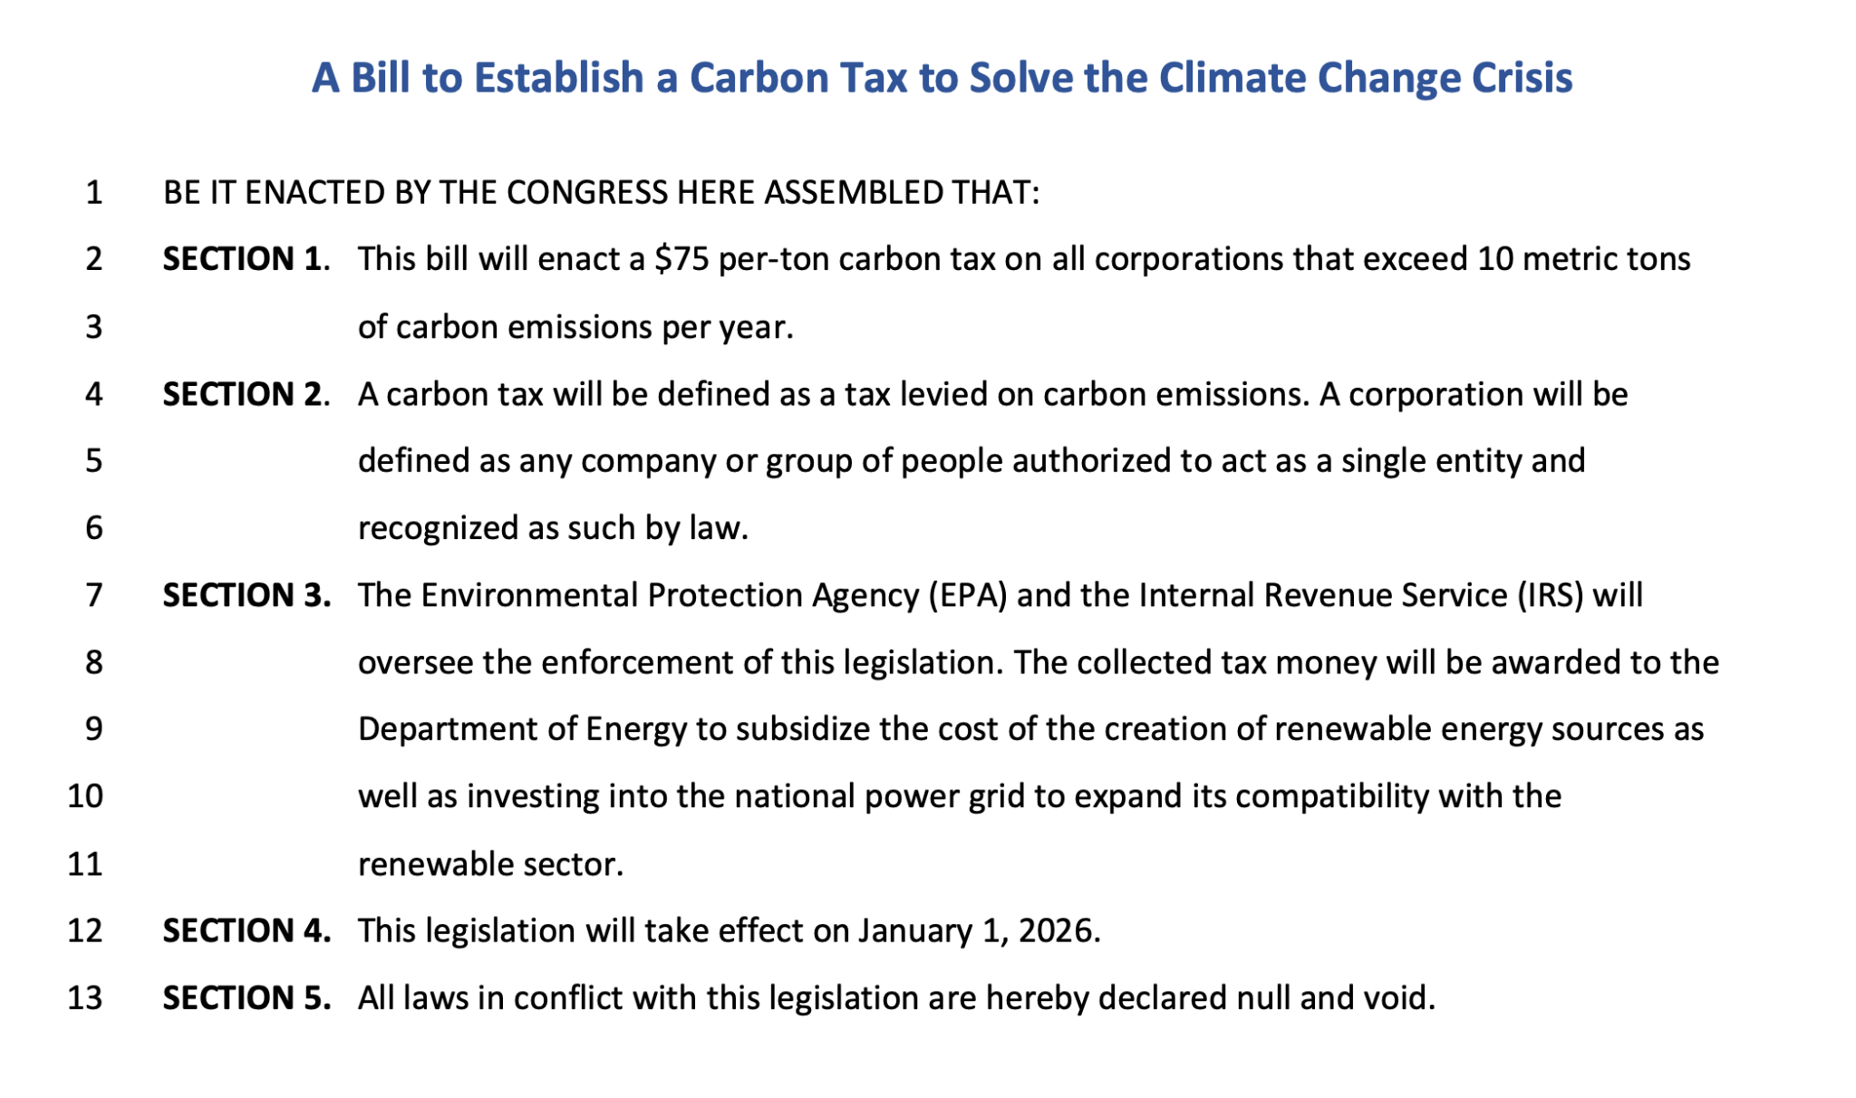
Example

Slide 7
So What Does “Stand Out” Prep/Research Look Like
Understand Why The Legislation Exists
Understand Why This Specific Solution is Being Prescribed
More Often than Not this Solution has Been Brought Up Somewhere
Start By Looking at Where This Was Implemented and What The Results Have Been
Put Together the Case

Slide 8
Paying
Attention

Slide 9
Now You are in Round
Pay Attention to Speakers on Your Side and the Opposition
Pay Attention to CX
Particularly Strong Questions you ask can/should be brought up

Slide 10
The Importance of Framing
Good Framing can Put You in T6 Easily
Someone that Frames the Round Really REALLY well and Has Good Evidence Can Win a Round
Framing comes from a good pre-requisite/overview that comes right after your intro right before your squo
Framing can also come after your outcome

Slide 11
Example
(Intro here)...
Pre: This debate has begun with the sponsor and the rest of my side saying that a Carbon Tax is needed now, while Sen.____ leading the negation has pointed out that this tax could severely hurt Americans. I believe that if my side can prove to you that a Carbon Tax can be implemented without severely hurting Americans financially we should pass this legislation. Let’s examine how we already have system in place that will ensure that.

Slide 12
Example
(Intro here)...
Pre: So far the negation has pointed out two things. 1 Labor will be exploited in Latin America by Corps, 2 Latin America is too tied to China. This legislation does not bind any country to our deal. It is simply a choice. If they think the choice is bad then they don’t need to take our deal. But I want to show you why us as an option is better than doing absolutely nothing.

